Slide 1
Introduction to Postgres
4-day series on Postgres RDMS covering everything from security to cloud

Slide 2
Introduction to Postgres
4-day series on Postgres RDMS covering everything from security to cloud

Slide 3
Day 1 Overview – Our Original Schedule
access control with pg_hba.conf
Configuring PostgreSQL for secure access with OpenSSL
Managing PostgreSQL clusters (postgresql.conf)
PostgreSQL logging
Creating & Managing PostgreSQL tablespaces and databases
Creating Indexes
Indexes on expressions
PostgreSQL Schemas
Partial indexes
Labs:
Installing Postgres 9.4 on Ubuntu
Configuring pg_hba.conf
Examining and configuration postgresql.conf
Variable Logging
Examining your cluster
Creating tablespaces, databases, and indexes
Exploring SChemas
Partial Indexes

Slide 4
Day 2 Overview - Our Original Schedule
Understanding PostgreSQL roles
User Roles
Backup and recovery (pg_dump, pg_dumpall, file system backups)
Performing Point-in-time recovery (PITR)
Assigning users to roles
PostgreSQL Write-ahead logs
Performing PITR backups
Performing PITR recovery
Using the psql client
Labs:
Creating roles, managing roles
Backup and Restore Sandbox (big lab)
PIT recovery of a system (big lab)
WAL exploration
PSQL tips and tricks (big lab)

Slide 5
Day 3 Overview - Our Original Schedule
Creating & Managing Indexes
Understanding the PostgreSQL query optimizer
Transactions and Concurrency
Using explain and explain analyze to optimize queries & indexes
Managing database privileges
Server monitoring & performance tuning
Access control with GRANT
PostgreSQL 9.4 Hot Standby & Streaming Replication
Labs:
Indexes lab
Exploring the Postgres query optimizer
Explain it all
Data privileges
Server Monitoring and Performance tuning lab
Access controls
Hot standby (big lab)

Slide 6
Day 4 Overview - Our Original Schedule
Understanding role access
Using PostgreSQL modules & add-ons
PostgreSQL data organization
Connection pooling with pgBouncer
PostgreSQL storage
Full Text indexing with tsearch2
Managing table space usage
Table Partitioning
Cloud, AWS, and RDS Postgress
Best practices Summary
Labs:
Creating and Managing Roles
Fun with Modules
pgBouncer Labs
Deeper Dive into STorage with Postgresql
Sample tsearch2
Let’s Partition
Manage an RDS instance

Slide 7
Day 1 Overview – Our New Schedule
Introductions
Your Project(s)
Platforms
Hardware
AWS EC2;AWS RDS
Postgresql Itself
History
Community/IRC/Mailing Lists
Capabilities
Postgresql Internals
Databases;Tablespaces
Schemas
Tables/Views/Indexes
Roles
Labs:
Installing Postgres 9.4 on Ubuntu locally; Launching EC2 Ubuntu; Launching RDS Instances
Getting Involved with the Community
Playing Around with a database

Slide 8
Day 2 Overview - Our New Schedule
Configuration Options in Postgresql (pg_hba.conf and postgresql.conf)
Logging and Basic Troubleshooting
Backup and Restore
Generic
PITR
Client Tips and Tricks
PSQL
PGADMIN 3 (talk about 4)
Labs:
Changing Options in Configuration
Reading and Tracking Logs
Backups and Restoration (big lab)
PSQL tips and tricks (big lab)

Slide 9
Day 3 Overview - Our New Schedule
Understanding the PostgreSQL query optimizer
Transactions and Concurrency
Using explain and explain analyze to optimize queries & indexes
Server monitoring & performance tuning
PostgreSQL 9.4 Hot Standby & Streaming Replication
Labs:
Exploring the Postgres query optimizer
Explain it all
Server Monitoring and Performance tuning lab
Hot standby (big lab)

Slide 10
Day 4 Overview - Our New Schedule
Using PostgreSQL modules & add-ons
PostgreSQL data organization
Connection pooling with pgBouncer
PostgreSQL storage
Full Text indexing with tsearch2
Managing table space usage
Table Partitioning
Cloud, AWS, and RDS Postgres
Best practices Summary
Labs:
Fun with Modules
pgBouncer Labs
Deeper Dive into Storage with Postgresql
Sample tsearch2
Let’s Partition
More Cloud

Slide 11
Our primary reference works
https://www.amazon.com/Learning-PostgreSQL-Salahaldin-Juba/dp/1783989181/ref=sr_1_4?ie=UTF8&qid=1471642346&sr=8-4&keywords=postgresql
Secondary Works that you might consider
https://www.amazon.com/PostgreSQL-Data-Architects-Jayadevan-Maymala/dp/1783288604/ref=sr_1_6?ie=UTF8&qid=1471642346&sr=8-6&keywords=postgresql
https://www.amazon.com/PostgreSQL-9-Administration-Cookbook-Second/dp/1849519064/ref=sr_1_3?ie=UTF8&qid=1471642346&sr=8-3&keywords=postgresql
https://www.amazon.com/Troubleshooting-PostgreSQL-Hans-Jurgen-Schonig/dp/1783555319/ref=sr_1_14?ie=UTF8&qid=1471642346&sr=8-14&keywords=postgresql
https://www.amazon.com/PostgreSQL-9-High-Availability-Cookbook/dp/1849516960/ref=sr_1_13?ie=UTF8&qid=1471642346&sr=8-13&keywords=postgresql
https://www.amazon.com/PostgreSQL-Administration-Essentials-Hans-Jurgen-Schonig/dp/1783988983/ref=sr_1_12?ie=UTF8&qid=1471642346&sr=8-12&keywords=postgresql

Slide 12

Who is Michael Forrester?
https://www.linkedin.com/in/performingpro

Slide 13
Introduction
Who are you?
What is your job title?
What do you actually do in your daily life?
What do you want to learn the most?

Slide 14

What is your project?
Details, Details, Details.

Slide 15
Platforms and Sizing
Hardware
Let’s talk about what you have now?
AWS EC2 – Let’s Start an EC2 Instance
https://aws.amazon.com/ec2/?nc2=h_m1
AWS RDS – Let’s Start and RDS Instance
https://aws.amazon.com/rds/?nc2=h_m1

Slide 16
What is PostgreSQL - In The Beginning…
PostgreSQL is an open source, object-oriented relational database management system that was originally developed at the Berkeley Computer Science Department of the University of California.
PostgreSQL is an advanced database server available on a wide range of platforms, ranging from Unix-based operating systems such as Oracle Solaris, IBM AIX, and HP-UX; Windows; and Mac OS X to Red Hat Linux and other Linux-based platforms.

Slide 17
Some Background and History
Created at Berkeley in 1982 by database’s legend Prof. Stonebraker In the 1994 Andrew Yu and Jolly Chen added the SQL interpreter In the 1996 becomes an Open Source project.
The project’s name changes in PostgreSQL
Fully ACID compliant
High performance in read/write with the MVCC
Tablespaces
Runs on almost any unix flavour
From the version 8.0 is native on *cough* MS Windows *cough*
HA with hot standby and streaming replication
Heterogeneous federation
Procedural languages (pl/pgsql, pl/python, pl/perl...)
Support for NOSQL features like HSTORE and JSON

Slide 18
Development Cycle for the open source team
Old ugly C language
New development cycle starts usually in June
New version released usually by the end of the year
At least 4 LTS versions
Can be extended using shared libraries
Extensions (9.1+)
BSD like license

Slide 19
Postgresql - History
https://www.safaribooksonline.com/library/view/learning-postgresql/9781783989188/ch02.html
https://www.postgresql.org/about/history/

Slide 20
Postgresql – Community/IRC/Mailing Lists
Community
https://www.postgresql.org/community/
http://planet.postgresql.org/
https://wiki.postgresql.org/wiki/Main_Page
http://www.pgsql.ru/db/pgsearch/
Documentation
https://www.postgresql.org/docs/
Mailing Lists
https://www.postgresql.org/list/
IRC
https://www.postgresql.org/community/irc/

Slide 21
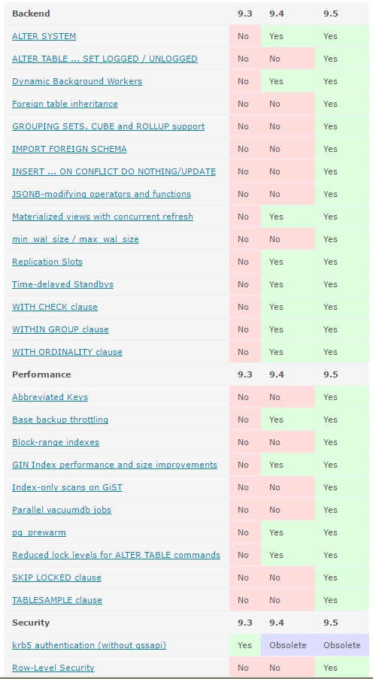
Postgresql – Capabilities
https://www.postgresql.org/about/featurematrix/

Slide 22
Postgresql – Internals
https://www.safaribooksonline.com/library/view/learning-postgresql/9781783989188/ch03s02.html
https://www.safaribooksonline.com/library/view/postgresql-for-data/9781783288601/ch02.html

Slide 23
Day 1 Overview – Our New Schedule
Introductions
Your Project(s)
Platforms
Hardware
AWS EC2;AWS RDS
Postgresql Itself
History
Community/IRC/Mailing Lists
Capabilities
Postgresql Internals
Databases;Tablespaces
Schemas
Tables/Views/Indexes
Roles
Labs:
Installing Postgres 9.4 on Ubuntu locally; Launching EC2 Ubuntu; Launching RDS Instances
Getting Involved with the Community
Playing Around with a database

Slide 24
Appendix

Slide 25
Creating Databases
A database is a systematic and organized collection of data which can be easily accessed, managed, and updated. It provides an efficient way of retrieving stored information. PostgreSQL is a powerful open source database. It is portable because it written in ANSI C. As a result, it is available for different platforms and is reliable. It is also ACID (short for Atomicity, Consistency, Isolation, Durability) compliant, supports transactions, is scalable as it supports multi version concurrency control (MVCC) and table partitioning, is secure as it employs host based access control and supports SSL, and provides high availability and replication by implementing features such as streaming replication and its support for point in time recovery.
Once you have downloaded and installed PostgreSQL, you will need to define the data directory, which is the storage location for all of the data files for the database. You will then need to initialize the data directory. Initialization of the data directory is covered under the recipe titled Initializing a database cluster. After this, you are ready to create the database.
To connect to a database using the psql utility, you can use the following command:
psql -h localhost -d postgres –p 5432
Here, we are basically connecting to the postgres database, which is resident on the localhost, that is the same server on which PostgreSQL was installed, and the connection is taking place on port 5432.
In the following code, we are creating a user, hr. Basically, this user is being created because in the next section, it is being used as the owner of the hrdb database:
CREATE USER hr with PASSWORD 'hr';

Slide 26
Creating Databases – How to Do It
PostgreSQL provides two methods to create a new database:
The first method relies on using the CREATE DATABASE SQL statement:
CREATE DATABASE hrdb WITH ENCODING='UTF8' OWNER=hr CONNECTION LIMIT=25;
The second method requires using the createdb command-line executable:
createdb –h localhost –p 5432 –U postgres testdb1

Slide 27
Creating Databases – How to Do It
PostgreSQL provides two methods to create a new database:
The first method relies on using the CREATE DATABASE SQL statement:
CREATE DATABASE hrdb WITH ENCODING='UTF8' OWNER=hr CONNECTION LIMIT=25;
The second method requires using the createdb command-line executable:
createdb –h localhost –p 5432 –U postgres testdb1

Slide 28
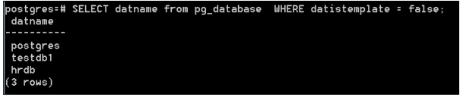
Creating Databases – How It Works
A database is a named collection of objects such as tables, functions, and so on. In order to create a database, the user must be either a superuser or must have the special CREATEDB privilege.
The createdb command-line executable connects to the postgres database when triggered, and then issues the CREATE DATABASE command.
You can view the list of existing databases by querying the pg_database catalog table, as shown in the following screenshot:
Alternatively, you may use \l switch of psql to view the list of existing databases.

Slide 29
Creating Schemas
Schemas are among the most important objects within a database. A schema is a named collection of tables. A schema may also contain views, indexes, sequences, data types, operators, and functions. Schemas help organize database objects into logical groups, which helps make these objects more manageable.

Slide 30
Creating Schemas – How to Do It
You can use the CREATE SCHEMA statement to create a new schema in PostgreSQL:
CREATE SCHEMA employee;
Alternatively, it is also possible to create a schema for a particular user:
CREATE SCHEMA university AUTHORIZATION bob;
Here, a schema called university is created and is owned by bob.

Slide 31
Creating Schemas – How It Works
A schema is a logical entity that helps organize objects and data in the database.
By default, if you don't create any schemas, any new objects will be created in the public schema.
In order to create a schema, the user must either be a superuser or must have the CREATE privilege for the current database.
Once a schema is created, it can be used to create new objects such as tables and views within that schema.

Slide 32
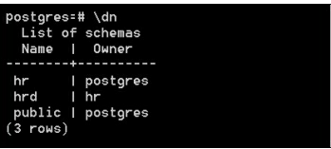
Creating Schemas – More
You may use the \dn switch of psql to list all of the schemas in a database as shown in the following screenshot:
To identify the schema in which you are currently working, you can use the following command:
SELECT current_schema();
While searching for objects in the database, you can define the search schemas preferences for where those searches should start. You can use the search_path parameter for this, as follows:
ALTER DATABASE hrd SET search_path TO hr,hrms, public, pg_catalog;

Slide 33
Creating Schemas – More
You may use the \dn switch of psql to list all of the schemas in a database as shown in the following screenshot:
To identify the schema in which you are currently working, you can use the following command:
SELECT current_schema();
While searching for objects in the database, you can define the search schemas preferences for where those searches should start. You can use the search_path parameter for this, as follows:
ALTER DATABASE hrd SET search_path TO hr,hrms, public, pg_catalog;

Slide 34
Creating Users
A user is a login role that is allowed to log in to the PostgreSQL server. The login roles section is where you define accounts for individual users for the PostgreSQL system. Each database user should have an individual account to log in to the PostgreSQL system. Each user has an internal system identifier in PostgreSQL, which is known as a sysid. The user's system ID is used to associate objects in a database with their owner. Users may also have global rights assigned to them when they are created. These rights determine whether a user is allowed to create or drop databases and whether the existing user is a superuser or not.

Slide 35
Creating Users – How to do it
PostgreSQL provides two methods by which database users are created:
The first method requires using the CREATE USER SQL statement to create a new user in the database. You can create a new user with the CREATE USER SQL statement, like this:
CREATE user agovil WITH PASSWORD 'Kh@rt0um';
Here, we created the agovil user and provided a password for the user to log in with.
The second method requires executing the createuser script from the command line.
We may also use the createdb script to create a user called nchabbra on the same host (port 5432), and the –S option specifies that the created user will not have the superuser privileges:
$ createuser -h localhost -p 5432 -S nchabbra

Slide 36
Creating Users – How It Works
The CREATE USER SQL statement requires one mandatory parameter which is the name of the new user. Other parameters, which are optional, however, are passwords for the user or group, the system ID, and a set of privileges that may be explicitly allocated.
The createuser script can be invoked without arguments. In that case, it will prompt us to provide the username and the set of rights and will attempt to make a local connection to PostgreSQL. It can also be invoked with options and the username to be created on the command line, and you will need to give the user access to a database explicitly if he/she is not the owner of the database.

Slide 37
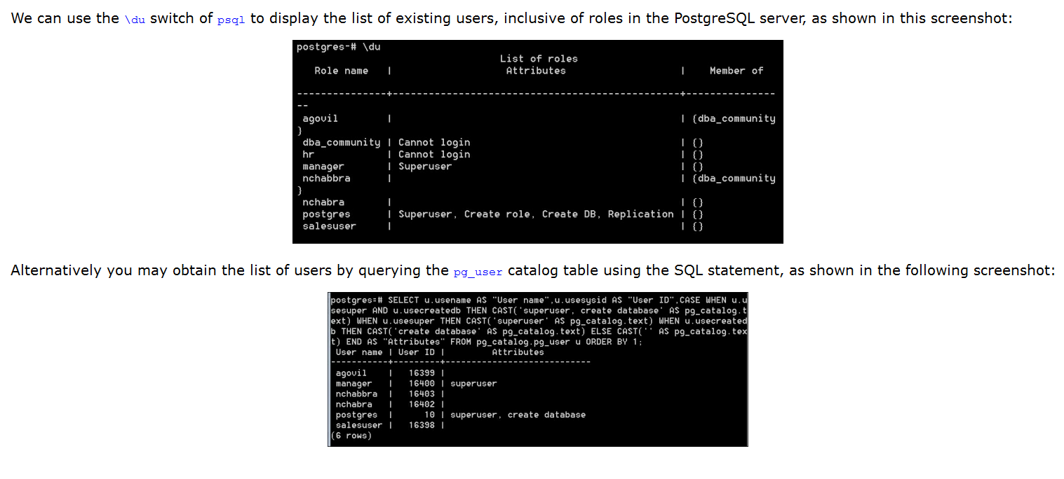
Creating Users – More

Slide 38
Creating Groups
A group in the PostgreSQL server is similar to the groups that exist in Unix and Linux. A group in PostgreSQL serves to simplify the assignment of rights. It simply requires a name and may be created empty. Once it is created, users who are intended to share common access rights are added into the group together, and are thus associated by their membership within that group. Grants on the database objects are then given to the group instead of each individual group member.

Slide 39
Creating Groups – How To Do It
Groups in the PostgreSQL server can be created by using the CREATE GROUP SQL statement. The following command will create a group. However, no users are currently a part of this group:
hrdb=# CREATE GROUP dept;
In order to assign members/users to the group, we can use the ALTER GROUP statement as follows:
hrdb=# ALTER GROUP dept ADD USER agovil,nchabbra;
It is also possible to create a group and assign users upon its creation, as shown in the following CREATE GROUP statement:
hrdb=# CREATE GROUP admins WITH user agovil,nchabbra;

Slide 40
Creating Groups – How It Works
A group is a system-wide database object that can be assigned privileges and have users added to it as members. A group is a role that cannot be used to log in to any database.
It is also possible to grant membership in a group to another group, thereby allowing the member role use of privileges assigned to the group it is a member of.
Database groups are global across a database cluster installation.

Slide 41
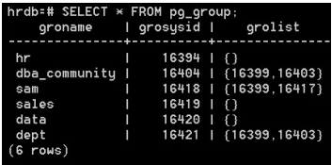
Creating Groups – More
To list all of the available groups in the PostgreSQL server instance, you need to query the pg_group catalog table, as shown in the following screenshot:

Slide 42
Deleting Databases
Every major RDBMS vendor offers the ability to drop databases just as it allows you to create databases. However, one should exercise caution when dealing with situations like dropping databases. Once a database is dropped, all of the information residing in it is lost forever. It is only for a valid business purpose that we should drop databases. In normal circumstances, a database is only dropped when it gets decommissioned and is no longer required for business operations.

Slide 43
Deleting Databases – How To Do It
There are two methods to drop a database in the PostgreSQL server instance:
You can use the DROP DATABASE statement to drop a database from PostgreSQL, as follows:
hrdb=# DROP DATABASE hrdb;
You can use the dropdb command line-utility, which is a wrapper around the DROP DATABASE command:
$ dropdb hrdb;

Slide 44
Deleting Databases – How It Works
The DROP DATABASE statement permanently deletes catalog entries and the data directory. Only the owner of the database can issue the DROP DATABASE statement.
Also, it is not possible to drop a database to which you are connected. In order to delete the database, the database owner will have to make a connection to another database of which he is an owner.

Slide 45
Deleting Databases – More
One situation that demands attention is when a user tries to drop a database that has active connections. The user will get an error when trying to drop such a database.
In order to drop a database that has active connections to it, you will have to follow these steps:
Identify all of the active sessions on the database. To identify all of the active sessions on the database, you need to query the pg_stat_activity catalog table as follows:
SELECT * from pg_stat_activity where datname='testdb1';
Terminate all of the active connections to the database. To terminate all of the active connections, you will need to use the pg_terminate_backend function as follows:
SELECT pg_terminate_backend(pid) FROM pg_stat_activity WHERE datname = 'testdb1';
Once all of the connections are terminated, you may proceed with dropping the database using the DROP DATABASE statement.

Slide 46
Creating Tablespaces
PostgreSQL stores data files consisting of database objects such as tables and indices on the disk. The tablespace is defined as the location of these objects on the disk. A tablespace is used to map a logical name to a physical location on the disk.
A tablespace is a location on the disk where PostgreSQL stores data files containing database objects, for example indexes, tables, and so on.
Before you create the tablespace, the directory location must be physically created and the directory must be empty:
mkdir –p /var/lib/pgsql/data/dbs

Slide 47
Creating Tablespaces – How To Do It
To create a tablespace in PostgreSQL, you need to use the CREATE TABLESPACE statement.
The following command creates a data_tbs tablespace, which is owned by the agovil user:
CREATE TABLESPACE data_tbs OWNER agovil LOCATION '/var/lib/pgsql/data/dbs';
Similarly, a tablespace in PostgreSQL can be dropped using the DROP TABLESPACE statement, as follows:
DROP TABLESPACE data_tbs;

Slide 48
Creating Tablespaces – How It Works
A tablespace allows you to control the disk layout of PostgreSQL. The owner of the tablespace, by default, would be the user who executed the CREATE TABLESPACE statement. This statement also gives you the option of assigning the ownership of the tablespace to a new user. This option is the part of the OWNER clause in the CREATE TABLESPACE statement.
The name of the tablespace should not begin with a pg_ prefix because this is reserved for the system tablespaces.
Before deleting a tablespace, ensure that it is empty, which means there should be no database objects inside it. If the user tries to delete the tablespace when it is not empty, the command will fail.
There are two options that will aid in deleting the tablespace when it is not empty:

Slide 49
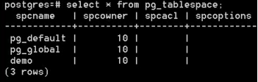
Creating Tablespaces – How It Works
You may drop the database
You may alter the database to move it to a different tablespace
After any of the preceding actions have been completed, then the corresponding tablespace may be dropped.
By default, two tablespaces exist in PostgreSQL:
pg_default: This is used to store user data
pg_global: This is used to store global data
You may query the pg_tablespace catalog table to get the list of existing tablespaces in PostgreSQL, as shown in the following screenshot:

Slide 50
Moving Objects Between Tablespaces 1
A tablespace can contain both permanent and temporary objects. You will need to define and create a secondary tablespace to serve as the target destination of objects that might get moved from the primary tablespace. Moving objects between tablespaces is a mechanism of copying bulk data in which copying happens sequentially, block by block. Moving a table to another tablespace locks it for the duration of the move.You may query the pg_tablespace catalog table to get the list of existing tablespaces in PostgreSQL, as shown in the following screenshot:
Here, we will first create a new tablespace, hrms, using the following command:
mkdir –p /var/lib/pgsql/data/hrms
Then we set the default tablespace for the testdb1 database to hrms using the following statement:
CREATE TABLESPACE HRMS OWNER agovil LOCATION '/var/lib/pgsql/data/hrms';
We will also create a table, insert some records into it, and create a corresponding index for it. This is being done because the table and its index will be used in the How to do it… section of this recipe:
***Prep****
CREATE TABLE EMPLOYEES(id integer PRIMARY KEY , name varchar(40));
INSERT INTO EMPLOYEES VALUES (1, 'Mike Johansson');
INSERT INTO EMPLOYEES VALUES(2, 'Rajat Arora');
CREATE INDEX emp_idx on employees(name);

Slide 51
Moving Objects Between Tablespaces 2
Moving a complete database to a different tablespace involves three steps:
You will change the tablespace for the given database so that new objects for the associated database are created in the new tablespace:
ALTER DATABASE testdb1 SET default_tablespace='hrms';
You will have to then move all of the existing tables in the corresponding database to the new tablespace:
ALTER TABLE employee SET TABLESPACE hrms;
You will also have to move any existing indexes to the new tablespace:
ALTER INDEX emp_idx SET TABLESPACE hrms;
You will have to query the pg_tables catalog table to find out which tables from the current database need to be moved to a different tablespace.
Similarly for the indexes, you will have to query the pg_indexes catalog table to find out which indexes need to be moved to a different tablespace.

Slide 52
Initializing a database cluster
In terms of a filesystem, a database cluster is a collection of databases that are managed by a single server instance, and it is the framework upon which PostgreSQL databases are created.
The initdb command is used to initialize or create the database cluster. The –D switch of the initdb command is used to specify the filesystem location for the database cluster.
To create the database cluster, use the initdb command:
$ initdb -D /var/lib/pgsql/data
Another way of initializing the database cluster is by calling the initdb command via the pg_ctl utility:
$ pg_ctl -D /var/lib/pgsql/data initdb
A database cluster is a collection of databases that are managed by a single server instance.
When the initdb command is triggered, the directories in which the database data will reside are created, shared catalog tables are generated, and the template1 and postgres databases are created, out of which the default database is postgres. The initdb command initializes the database cluster default locale and the character set encoding.
You can refer to http://www.postgresql.org/docs/9.4/static/creating-cluster.html for more information on initializing a database cluster.

Slide 53
Terminating Connections – How to Do It
Every major RDBMS, including PostgreSQL, allows simultaneous and concurrent database connections in order for users to run transactions. Due to such concurrent processing of databases, it may be during peak transaction hours that database performance becomes slow or that there are some blocking sessions. In order to deal with such situations, we might have to terminate some specific sessions or sessions coming from a particular user so that we can get database performance back to normal.
PostgreSQL provides the pg_terminate_backend function to kill a specific session. Even though the pg_terminate_backend function acts on a single connection at a time, we can embed pg_terminate_backend by wrapping it around the SELECT query to kill multiple connections, based on the filter criteria specified in the WHERE clause.
To terminate all of the connections from a particular database, we can use the pg_terminate_backend function as follows:
SELECT pg_terminate_backend(pid) FROM pg_stat_activity WHERE datname = 'testdb1';
To terminate all of the connections for a particular user, we can use pg_terminate_backend like this:
SELECT pg_terminate_backend(pid) FROM pg_stat_activity WHERE usename = 'agovil';

Slide 54
Terminating Connections – How It Works
The pg_terminate_backend function requires the pid column or process ID as input. The value of pid can be obtained from the pg_stat_activity catalog table. Once pid is passed as input to the pg_terminate_backend function, all running queries will automatically be canceled and it will terminate a specific connection corresponding to the process ID as found in the pg_stat_activity table.
Terminating backends is also useful to free memory from idle postgres processes that was not released for whatever reason and was hogging system resources.
If the requirement is to cancel running queries and not to terminate existing sessions, then we can use the pg_cancel_backend function to cancel all active queries on a connection. However, with the pg_cancel_backend function, we can only kill runaway queries issued in a database or by a specific user. It does not have the ability to terminate connections.
To cancel all of the running queries issued against a database, we can use the pg_cancel_backend function as follows:
SELECT pg_cancel_backend(pid) FROM pg_stat_activity WHERE datname = 'testdb1';
To cancel all of the running queries issued by a specific user, we can use the pg_cancel_backend function like this:
SELECT pg_cancel_backend(pid) FROM pg_stat_activity WHERE usename = 'agovil';
In versions before PostgreSQL 9.2, the procpid column has to be passed as input to the pg_terminate_backend and pg_cancel_backend functions to terminate running sessions and cancel queries. The pid column replaced the procpid column from PostgreSQL version 9.2 onwards.
You may refer to https://blog.sleeplessbeastie.eu/2014/07/23/how-to-terminate-postgresql-sessions/ and http://www.devopsderek.com/blog/2012/11/13/list-and-disconnect-postgresql-db-sessions/ for more information regarding terminating backend connections.

Slide 55
Limits
Database size. No limits.
Table size 32 TB
Row size 1.6 TB
Field size 1 GB
Rows in table. No limits.
Fields in table 250 - 1600 depending on data type.
Tables in a database. No limits.

Slide 56
Controlling access via configuration files
Once the firewall is configured to allow access to the PostgreSQL server, you need to configure the PostgreSQL server to allow remote connections. This is implemented by making the necessary changes in the postgresql.conf and pg_hba.conf configuration files.
The postgresql.conf file contains a single entry that controls on which network interfaces PostgreSQL listens for connections.
The pg_hba.conf file is used to define which clients can connect to which database and using which login role.

Slide 57
Authentication in postgresql
Authentication answers the question, who is the user? PostgreSQL supports several authentication methods, including trust, ident, password, GSSAPI, SSPI, LDAP, PAM, and so on. To understand authentication, one needs to have the following information:
Authentication is controlled via a pg_hba.conf file, where hba stands for host-based authentication.
It is good to know the default initial authentication settings shipped with PostgreSQL distribution.
The pg_hba.conf file is often located in the data directory, but it also can be specified in the postgresql.conf configuration file.
When changing the authentication, one needs to send a SIGHUP signal, and this is done via several methods based on the PostgreSQL platform. Also note that the user who sends the signal should be a superuser or the postgres or a root system user on the Linux distribution; again, this depends on the platform.psql -U postgres -c "SELECT pg_reload_conf();"sudo service postgresql reloadsudo /etc/init.d/postgresql reloadsudo Kill -HUP <postgres process id>
The order of pg_hba.conf records matters. The session connection is compared with pg_hba.conf records one by one until it is rejected or the end of the configuration file is reached.
Finally, it is important to check the PostgreSQL log files to determine whether there are errors after configuration reload.

Slide 58
Pg_hba.conf – How it works
Client authentication is controlled by the pg_hba.conf configuration file. Entries in the pg_hba.conf file govern the authentication and authorization permissions for a host.
Entries in the pg_hba.conf file will be read for authentication whenever a connection request is received. Initially, the pg_hba.conf file is used to determine whether a client
making a database connection request has the CONNECT privilege on a database object or not. Once it has been determined that a user is allowed to access the database, the next step is to ensure that all the conditions are met for the client to authenticate successfully.
Even if the user is authenticated and has permissions to connect to a database, any of the table-level permissions will still apply to the database. You can check the permissions on the database using the \z switch, as shown in the screenshot below:
During the initialization of a database connection, entries in the pg_hba.conf file are read from top to bottom. The moment a matching entry is found, PostgreSQL will stop the search and it will allow or reject a connection based on the mentioned rules for the found entry. The connection will fail completely if a matching entry is not located in the pg_hba.conf file.

Slide 59
Pg_hba.conf – The File itself
As in postgresql.conf, the pg_hba.conf file is composed of a set of records, lines can be commented using the hash sign, and spaces are ignored. The structure of the pg_hba.conf file record is as follows:
host_type database user [IP-address| address] [IP-mask] auth-method [auth-options]
The host_type part of this query can be:
Local: This is used in Linux systems to allow users to access PostgreSQL using socket connections
Host: This is to allow connections from other hosts, either based on the address or IP address, using TCP/IP with and without SSL encryption
Hostssl: This is similar to host, but the connection should be encrypted using SSL in this case
Hostnossl: This is also similar to host, but the connection should not be encrypted in this case
The database part of the query is the name of the database that the user would like to connect to. For flexibility, one could also use a comma-separated list to specify several databases, or one could use all to indicate that the user can access all the databases in the database cluster. Also, the sameuser and samerole values can be used to indicate that the database name is the same as the username or the user is a member of a role with the same name as the database.
The user part of the query specifies the database user's name; again, the all value matches all users. The IP address, address, and IP subnet mask are used to identify the host where the user tries to connect from. The IP address can be specified using a CIDR or dot decimal notation. Finally, the password authentication methods can be trust md5, reject, and so on.

Slide 60
Pg_hba.conf – How to do it
You need to configure the listen_addresses configuration parameter in order to enable the remote network clients to make a connection to the PostgreSQL server:
listen_addresses = '*'
Here, you use an asterisk as the value of the listen_addresses configuration parameter. This configuration parameter enables all network ports.
The next step will be to make changes in the pg_hba.conf configuration file. These changes define access rules in order to allow remote connections access to the PostgreSQL server.
Open the pg_hba.conf file under the data directory or under the directory defined by the $PGDATA environment variable and define the necessary access control rules:
# TYPE DATABASE USER CIDR-ADDRESS METHOD OPTION
host hrdb all 192.168.12.10/32 md5
host all all 192.168.54.1/32 reject
host all all 192.168.1.0/24 trust
host hrd all 192.168.1.10/24 crypt
The first entry in the pg_hba.conf file signifies that any user from the host 192.168.12.10 is allowed to connect to the hrdb database if the user's password is supplied correctly.
The second entry in the pg_hba.conf file shows a host record that will reject all the users from the host 192.168.54.1 for any requested database.
The third entry in the pg_hba.conf file shows a host record that allows any machine on the 192.168.1.0 subnet to connect and access any database without specifying any password. Basically, with the trust method, we are relying on host-based authentication with the use of this method.
The final entry in the pg_hba.conf file states that any user with an IP address 192.168.1.10 and with a valid password is allowed to connect to the hrdb database. However, here the password will be encrypted during authentication because of the term crypt, which is specified as the authentication method.

Slide 61
Pg_hba.conf – There’s more
An authentication method type known as ident is defined in the pg_hba.conf configuration file. The ident authentication method works by obtaining the client's operating system username and using it as the allowed database username.
If the ident authentication method is used for a host entry in the pg_hba.conf file, then an ident map or a named mapping need to be specified. This option is defined in the pg_ident.conf configuration file, and it is used to map the identifying username, that is the client operating system username with an existing PostgreSQL database user.
The key aspect here is to obtain the client's operating system username so that it can be mapped to an existing database PostgreSQL database user.
Similar to the pg_hba.conf file, the pg_ident.conf file is also located in the data directory or in the path specified by the PGDATA environment variable.
First, the ident term must be set as the authentication method in the pg_hba.conf file, as follows:
# TYPE DATABASE USER CIDR-ADDRESS METHOD OPTION
host hrdb all 192.168.12.10/32 ident hruser
Here, in the pga_hba.conf file, any user using the IP address 192.168.12.10 can connect to the hrdb database using an hruser mapname, which is basically a mapping of the UNIX usernames and the corresponding PostgreSQL database username. These entries are defined in the pg_ident.conf file, as follows:
# MAPNAME Ident-USERNAME PG-USERNAME
hruser govil_amit agovil

Slide 62
Pg_hba.conf – There’s more
hruser kumar_neeraj agovil
The hruser identmap is now configured in the pg_ident.conf file. The entries in the pg_ident.conf file allow either of the UNIX system users, govil_amit and kumar_neeraj, to connect to the hrdb database using the PostgreSQL system user account agovil.
For more information on the entries in the pg_hba.conf file, you can refer to http://www.postgresql.org/docs/9.4/static/auth-pg-hba-conf.html.

Slide 63
Why SSL in Postgres?
By default, the PostgreSQL server is configured to accept remote client connections using a standard TCP connection. The issue with these type of network connections is that the data is sent in clear text over the network and is clearly susceptible to sniffing. Anyone using a network sniffer can easily intercept the data sent in clear text, and in this way, the data confidentiality can be compromised.
Now, the pertinent question is what data in PostgreSQL will be susceptible to sniffing. The SQL statement sent by the psql utility to the server and the result set generated by the PostgreSQL server are some of the things that are susceptible to sniffing. Getting an interceptor to see the result set of the query means enabling the network sniffer to see your table data.
To deal with this situation, PostgreSQL supports Secure Sockets Layer (SSL) encrypted TCP sessions. SSL-based TCP encrypted sessions use an encryption key to encrypt data before it is sent out on the network. The PostgreSQL server and the client machine pass an encryption key that is used to encrypt data.

Slide 64
SSL in Postgres – How to Do It!
In order to deal with this, you need to enable SSL support in PostgreSQL. This can be done by modifying the value of the ssl configuration parameter in the postgresql.conf file:
ssl = on
When the PostgreSQL server is restarted, it will recognize the change in the configuration and enable SSL connections. The PostgreSQL server will now listen for both normal TCP connections, as well as secure SSL-based TCP connections on the same port.
However, once SSL is enabled, the PostgreSQL server will make sure that the encryption keys or certificate files are available in the PostgreSQL data directory, otherwise it will not start until it finds them.

Slide 65
SSL in Postgres – How It Works!
Now that SSL support is enabled in PostgreSQL, to support an SSL session, the PostgreSQL server must have access to both an encryption key and a certificate. The SSL protocol uses the encryption key to encrypt network data, while the remote client uses the certificate supplied by the server to validate that the encryption key came from a trusted source.
The encryption key is generated from a certificate signed by an organization that the client trusts. These two methods can be used to obtain a certificate:
You can purchase a certificate from a certification authority such as Verisign or Thawte
In other situations, you can create a self-signed certificate, indicating that the encryption came from your end
There's more...

Slide 66
SSL in Postgres – More
Here we are going to create a self-signed certificate and encryption keys using an open source tool know as OpenSSL. For Windows, you need to download the latest version of the Win32OpenSSL package.
The following steps are required to create the encryption key and self-signed certificate files:
Create a passphrase protected encryption key.
Remove the key passphrase.
Create the self-signed certificate.

Slide 67
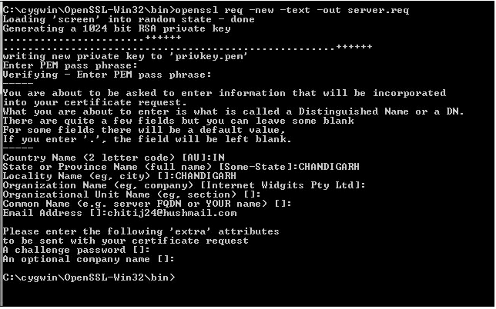
SSL in Postgres – More
The first step is to create the encryption key used by PostgreSQL for encrypting SSL sessions. This is done using the req OpenSSL option:
The preceding step creates a file called privkey.pem, which contains the encryption key and the server.req file, which contains a basic certificate:

Slide 68
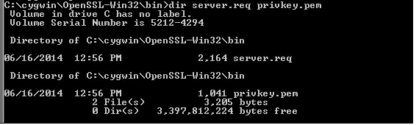
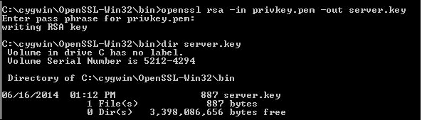
SSL in Postgres – More
As mentioned earlier, the file that contains the privkey.pem encryption key is protected by a passphrase. You can remove this passphrase from the encryption key using another SSL option, as follows:

Slide 69
SSL in Postgres – More
When the previously mentioned openssl command is executed, OpenSSL asks for the passphrase for the encryption key. It then creates a new encryption key, called server.key, which does not require the pass phrase to be entered.
Now that you have an encryption key without a pass phrase and a basic certificate, the next step is to convert the certificate to a standard X.509 format and self sign it using the encryption key:
C:\cygwin\OpenSSL-Win32\bin>openssl req -x509 -in server.req -text -key server.key -out server.crt
Loading 'screen' into random state – done

Slide 70
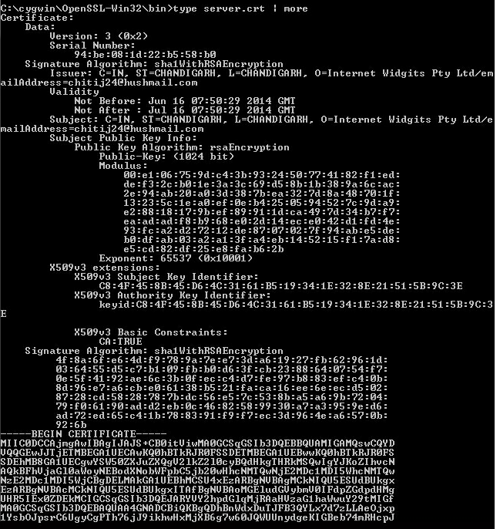
SSL in Postgres – More
The certificate is created in the text mode using the standard X.509 format and is saved in the server.crt file. As the certificate was created in the text mode, let's take a look at it:

Slide 71
SSL in Postgres – More
The certificate is created in the text mode using the standard X.509 format and is saved in the server.crt file. As the certificate was created in the text mode, let's take a look at it:
The next step will be to copy the server.key and server.crt files to the PostgreSQL data directory and then restart the PostgreSQL server service.
For more information on SSL in PostgreSQL, you can refer to www.postgresql.org/docs/9.4/static/ssl-tcp.html.

